Slide 1
Team Members:
Nelson Wang
Aditi Sharma
Bill Wilson
Gayatri Pingale
Notes:
Good morning everyone. Hope, you all are doing well.
Today Nelson, Bill, Aditi and I are here to present our solution to a common problem.

Slide 2


Think Before You Move!
Notes:
Moving, especially to another sate, is always a major hassle.
The following visualization is meant to assist you in deciding which US-state is the best to live in.

Slide 3
Our Solution:
Analyze 40 years worth of information for the following:
unemployment rate
crime rate
population
classification of state
years
Develop a concise, 5-dimentional visual representation.
Add the map for the user convenience.
Notes:
We take into consideration all these categories.

Slide 4
This solution is better than:
Reading boring tables
Flipping through multi-page analyses or surveys
Calling friends/acquaintances.

Slide 5

Technologies we use
Python
JavaScript/jQuery
HTML/CSS
D3.js
Leaflet
MySQL /SQLite
SQLAlchemy
Flask
Notes:
These are the technologies we used in our project.
I hope, you will use our app if you decide to move.
Now Bill will explain how we worked on the data.

Slide 6
States Data:
Source of Data:
Bureau of Labor Statistics:
Uniform Crime Reporting Statistics.

Slide 7
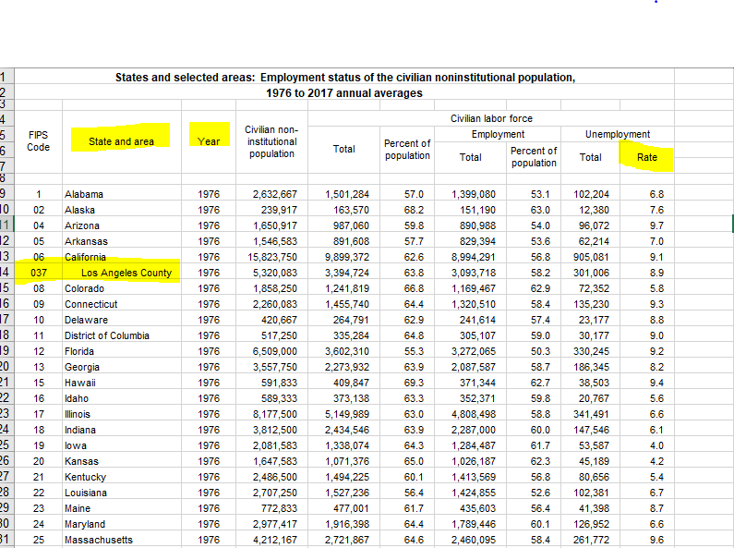
Bureau of Labor Statistics: Unemployment Rate

Slide 8
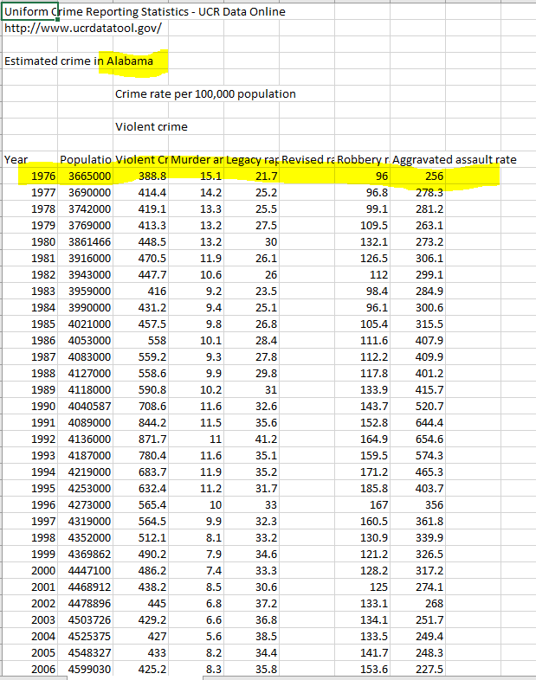
Uniform Crime Reporting Statistics: Population and Violent Crime Data

Slide 9
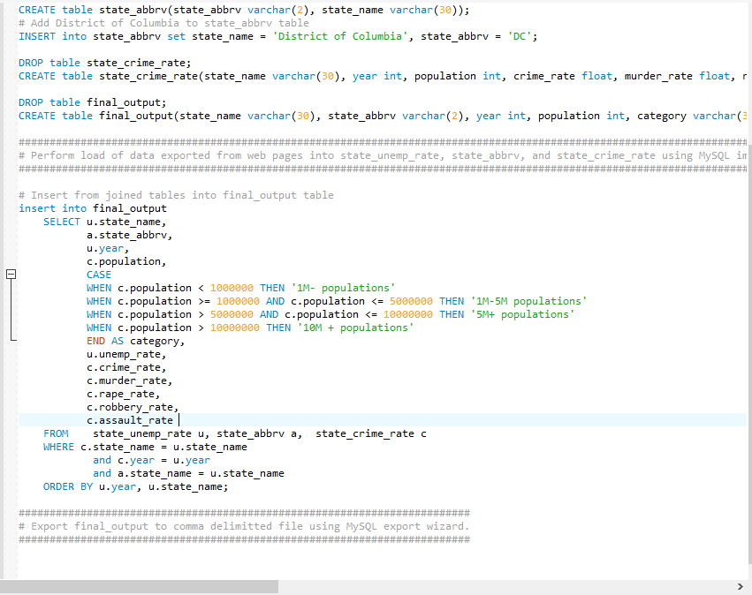
Organized Data using MySQL

Slide 10
From MySQL to sqlite db
Load sqlite database with final data
From flask route: Select data from sqlite database using sqlAlchemy and pass jsonified data to be read from d3

Slide 11
Observations:
In the 20th century, the data points are more spread out, indicating that the states are impacted individually by the economy and crime rate independent of each other, rather than together en-masse.
In the 21st century, the data points are concentrated in the middle of the x-axis and move as a mass unlike in 20th century.

Slide 12
Interesting fact:
In DC, even when the unemployment changes, its crime rate is minimally affected unlike in other states.
Throughout the years, DC continually has the highest crime rate.
If you select on North Dakota and step from 2007 - 2010 you can see that bank failures on Wall Street didn't affect them too much as far as unemployment in concerned. All the rest of the states took a big leap upward.

Slide 13



